Slide 1

Stock Return Predictor
By Andrew and Aditya
19 May 2020

Slide 2
Outline
Problem Statement
Challenges and Motivation
The Dataset
What is State of the Art
Solution and Evaluation
Questions

Slide 3
Problem Statement
Original Problem – Predict Presidential Candidate voter will choose
New Problem – Predict the return of an un-disclosed stock

Slide 4


Challenges and Motivation
Original Challenge
Candidate’s and Voter’s views change constantly
Policies not easy to understand
Policy and Issue novelty of each election makes previous data irrelevant
Not enough data with survey - https://mason.gmu.edu/~mwilli90/
New Challenge
Share prices are volatile
Physical vs Physiological Factors
Rational and Irrational Behavior
Global/National/Regional Socio-Economic Factors
Lack of individual stock information
*Motivation – Novelty and ability to incorporate CS 584 techniques

Slide 5
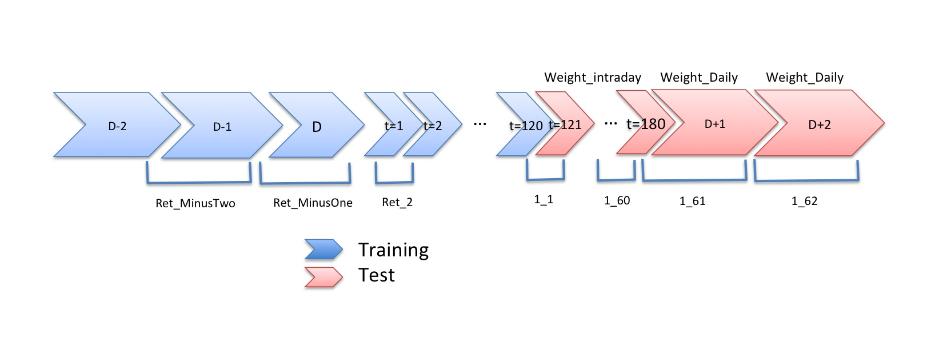
The New Dataset
444 Megabytes
Training Set – 275 MB
Test Set – 169 MB
HW3/HW4 <= 50 Megabytes
Training Set
40,000 instances
211 Features
Test Set
120,000 instances
147 Features
Feature_1 – Feature_25
Ret_MinusTwo
Ret_MinusOne
Ret_2 – Ret_120
Ret_121 – Ret_180
RetPlusOne
RetPlusTwo
Weight_Intraday
Weight_Daily

Slide 6
New State of the Art
While ANN multilayer perceptron’s historically have not yielded any more reliable results than simpler techniques such as moving averages, KNN, and prophet.
There are some sources which report slightly better reliability using deep learning methods based on Convolutional Neural Networks and recurrent neural network on a LSTM model.

Slide 7
Solution and Evaluation
Experimenting all the approaches and techniques Linear regression lead to the lowest WMAE .
We evaluated the model using WMAE of the model prediction and the compared it with the baseline model of just predicting the mean of the returns.
In the end, we observed that our model was predicting significantly good results than the baseline model.

Slide 8


Questions

